Slide 1

Targeted Marketing in Banking Sector
Prakash Bajracharya
Module 8: Portfolio Project - Presentation
MIS 581 – Capstone Business Intelligence and Data Analytics
Colorado State University-Global Campus
Dr. Justin Bateh 06/08/2024

Slide 2
Introduction
Importance of targeted marketing in banking
Use of predictive analytics for precision marketing

Slide 3
Problem Statement
Traditional marketing inefficiencies
Need for data-driven approaches

Slide 4
Objectives
Develop predictive model
Enhance campaign accuracy and efficiency
Optimize resource allocation

Slide 5
Dataset Description
Source: UCI Machine Learning Repository
41,188 entries, 21 variables
Includes demographic, transactional, and economic data

Slide 6
Methodology
Quantitative research
Logistic regression analysis
Tools: R-Studio, dplyr, ggplot2

Slide 7
Hypotheses
H1: Method of contact affects subscription rates
H2: Age affects subscription rates
H3: Previous engagement affects subscription rates

Slide 8
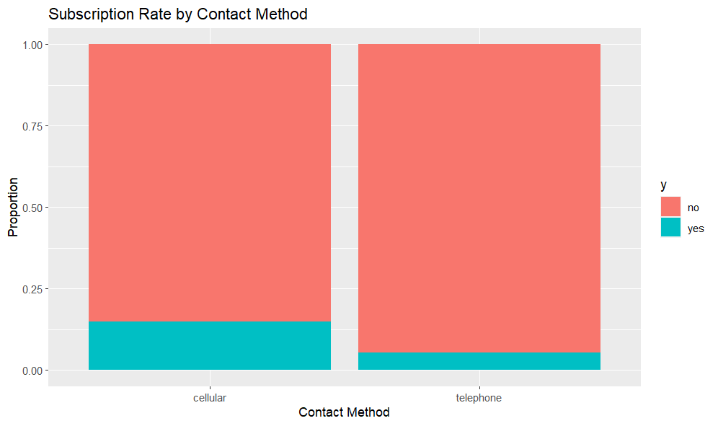
Findings – H1 Method of Contact
Significant impact of contact method
Higher subscription rates via cellular phones
Chi-square test: p-value < 2.2e-16
Bar chart showing subscription rates by age group

Slide 9
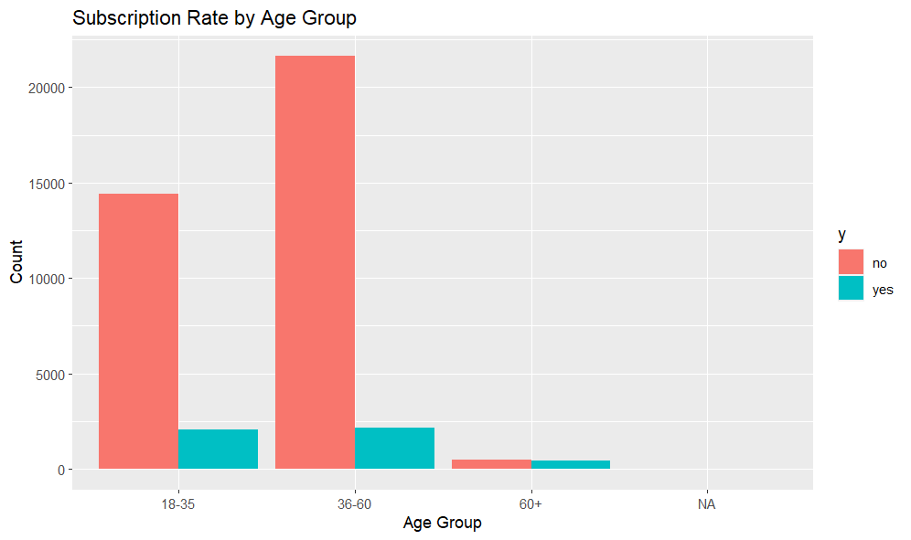
Findings – H2 Age Effect
No significant impact of age on subscription rates
Chi-square test: p-value = 1
Bar chart showing subscription rates by age group

Slide 10
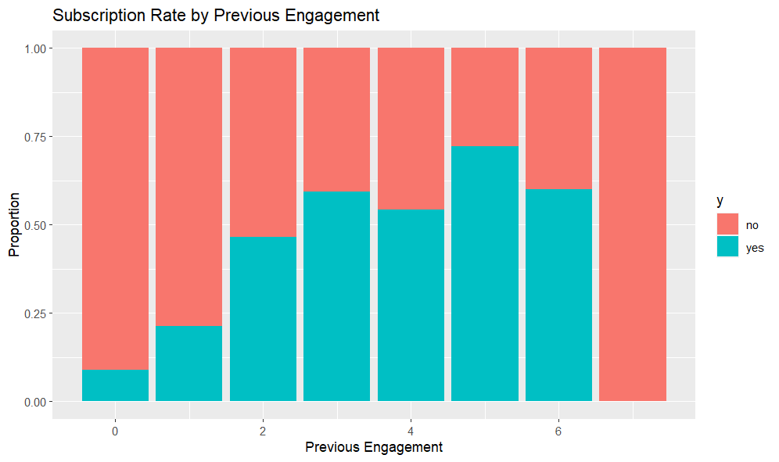
Findings – H3 Previous Engagement
Significant impact of previous engagement
Higher subscription rates with more past interactions
Chi-square test: p-value < 2.2e-16
Bar chart showing subscription rates by previous engagement

Slide 11
Recommendations
Prioritize mobile communication for higher engagement
Leverage detailed customer data for personalized marketing
Maintain consistent and targeted customer engagement
Ensure data accuracy through regular audits
Integrate ethical considerations to maintain customer trust

Slide 12
Future Research
Explore additional variables like income level and financial literacy
Conduct longitudinal studies to track customer behavior over time
Employ advanced machine learning techniques for better prediction
Incorporate customer satisfaction metrics to boost loyalty
Perform cross-bank comparisons to identify best practices
Integrate real-time data for dynamic decision-making

Slide 13
Conclusion
Summary of key findings
Importance of predictive analytics
Future research directions

Slide 14
References
Moro,S., Rita,P., and Cortez,P.. (2012). Bank Marketing. UCI Machine Learning Repository. https://doi.org/10.24432/C5K306.
McCarthy, et al. (2022). Applying Predictive Analytics: Finding Values in Data. Springer Nature Switzerland AG.
Smith, J., & Johnson, A. (2023). The Impact of Demographic Characteristics on Marketing Campaign Success in the Banking Sector. Journal of Marketing Research, 8(2).

Slide 15
References
Garcia, M., & Rodriguez, L. (2022). Optimizing Communication Channels in Banking Marketing Campaigns: A Comparative Analysis. Banking and Finance Review, 15(3).
Oliveira, R., & Pereira, S. (2021). Customer Engagement and Marketing Success: Insights from Portuguese Bank Marketing Campaigns. International Journal of Bank Marketing, 25(4).
Chen, Y., & Wang, H. (2020). Enhancing Marketing Effectiveness through Ethical Considerations: A Case Study in the Banking Sector. Journal of Business Ethics, 12(1).

Slide 16
References
Jiang, Y.B. (2018). Using Logistic Regression Model to Predict the Success of Bank Telemarketing. Journal of Data Science, 4(35).
Shaik, Subhani, Vijaya Kumar, R., Peram, Subba, & Rao, B. (2021).
Bank Marketing Using Intelligent Targeting. 10.1007/978-981-15-9516-5_40.
Moro,S., Rita,P., and Cortez,P.. (2012). Bank Marketing. UCI Machine Learning Repository. https://doi.org/10.24432/C5K306.

